Slide 1
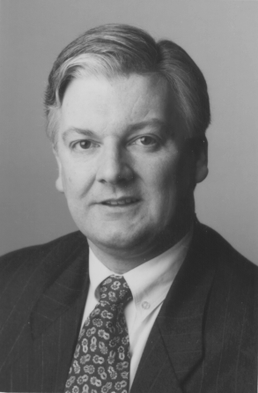
HON PETER DUNNE
Leader, United Future New Zealand
MP for Ohariu-Belmont
Hon Peter Dunne was born in Christchurch in1954.
He graduated from the University of Canterbury in 1977 with a Master of Arts degree with Honours in Political Science, and has also studied business administration at Massey University. He was President of the University of Canterbury Students’ Association in 1975.
After graduation, he worked for the Department of Trade and Industry in Wellington during 1977-78, prior to joining the Alcoholic Liquor Advisory Council where he was Council Secretary (1978-80); Deputy Chief Executive (1980-84); and Acting Chief Executive (1984).
He was Labour MP for the north-west Wellington seat of Ohariu from 1984 to 1993. Following boundary changes, he was elected MP for the new seat of Onslow in 1993. In 1996 he was elected as United New Zealand MP for Ohariu-Belmont.
He was appointed Parliamentary Under-Secretary to the Ministers of Health (1987-89); Trade and Industry (1987-89); Energy (1988-89); Regional Development (1988-90); Commerce (1988-90); Justice (1989); Environment (1989-90); Internal Affairs (1989-90); and Local Government (1989-90).
He was a member of the Finance and Expenditure Select Committee from 1984 to 1987 and from 1990 to 2002, serving as its deputy chair from 1996 to 1999, and 1999 to 2002, and its chair in 1999. He has been chair of the Foreign Affairs, Defence and Trade Select Committee since 2002. He is a member of the Standing Orders Select Committee (2000 -); the Parliamentary Service Commission (2001 -); and the Privileges Committee (2002 -).
From February to November 1990 he was Minister of Regional Development, Associate Minister for the Environment, and Associate Minister of Justice.
Mr Dunne resigned from the Labour Party in October 1994, having been the Opposition Spokesperson on Commerce, Customs, and Revenue, and a member of the Opposition’s front bench. He was a founding member of United New Zealand in 1995, and became its leader in October 1996.
Following the formal coalition agreement between United New Zealand and the National Party in February 1996, Mr Dunne was appointed Minister of Revenue and Minister of Internal Affairs, serving until the end of the coalition in December 1996.
In 2000 United joined with Future New Zealand to form United Future and Mr Dunne was elected Leader of this new party.
After United Future’s success at the 2002 general election, the party entered into a confidence and supply agreement with the minority Labour/Progressive Governmment.
Mr Dunne was made an Associate Fellow of the New Zealand Institute of Management in 1988, and has been a member of the board of the Institute of Policy Studies at Victoria University since 1987; a member of the board of directors of Employee Assistance Programmes Services from 1991 to 1997; a trustee of the Business and Parliament Trust since 1991, and chairman of its executive committee from 1992 to 1998. He has been a Trustee of the Asia 2000 Foundation since 2002. He has been a radio talkback host (1994-95) and a broadcaster with Wellington Access Radio since 1997. He is the author of “Home is Where My Heart Is”, published in 2002.
He has been married to Jennifer Mackrell since 1976 and they have two sons.

